Slide 1
The Educational Value of Video Games

Slide 2
When we think of the effects of video games on our population, do images such as this pop into our heads?

Slide 3
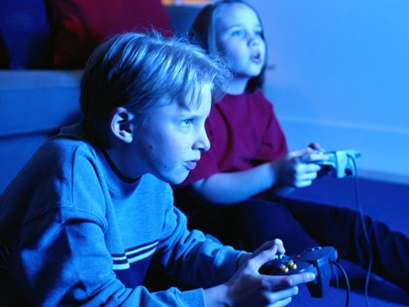
We are now starting to observe that not all of the effects of video games on our children are negative.
Some of the skills exhibited by game-players include:
Persistence
Risk- Taking
Attention to Detail
Problem- Solving

Slide 4
Educators today are learning to harness the power of video games to enhance the learning experience in their classrooms.
A middle school teacher in Cambridge, Massachusetts uses the computer game DIPLOMACY to enhance the instruction in his classroom. While discovering the causes of World War I, the students are also learning to :
negotiate
solve problems collaboratively
view how their actions impact others

Slide 5
Two high school physics teachers in Lawrence, Massachusetts are utilizing Starlogo TNG, a 3-D modeling and simulation software package, to create digital simulations for their classrooms.
The benefits to this type of software include:
Situations are created that would otherwise be difficult for the students to experience
Students demonstrate creative problem-solving skills
Students can prove mastery of the concepts being taught

Slide 6
What students are saying about the use of video gaming technology in the classroom
We surveyed the students in a typical fifth grade classroom to see how they felt about the use of educational technology. The results were as follows:
100% of the students surveyed play electronic games
60% of the students play educational games at home
58.1% of the students said that educational games help you learn
66.7% of the students would rather learn by playing video games

Slide 7
Technology can be a powerful tool for instruction inside and outside the classroom.
There are many valid arguments to be made for the inclusion of educational games within the classroom:
Most students are already familiar with gaming technology and are comfortable in the digital world
Studies have shown that games can improve skills in communication, problem-solving and number-related skills.
Video games can adjust difficulty on an individual basis. The player can work within their competency level.

Slide 8
References:
Kimberly, Jean. Video Games & Learning Games May not be the Enemy. 09 Sept. 2009. International Society for Technology in Education. 29 Nov. 2010 <http://www.iste.org/connect/iste-connects/blog-detail/09-09-09/Video_Games_Learning_Games_May_Not_be_the_Enemy.aspx>.
Klopfer, Eric, Scot Osterweil, and Katie Salen. the education arcade. n.d. Massachusetts Institute of Technology. 29 Nov. 2010 <http://education.mit.edu/papers/MovingLearningGamesForward_EdArcade.pdf>.
Klopfer, Eric, Scot Osterweil, and Katie Salen. the education arcade. n.d. Massachusetts Institute of Technology. 29 Nov. 2010 <http://education.mit.edu/papers/MovingLearningGamesFor...>.
Credits:
Cathy Slocum
Erin Lewis
Joshua Frisch

